Slide 1

KRISHNA CHAITANYA INSTITUTE OF TECHNOLOGY & SCIENCES
(Approved by AICTE, New Delhi & Affiliated to JNTU Kakinada)
A
Seminar Report on
REACT.JS
Submitted for the partial fulfillment
of
BACHELOR OF TECHNOLOGY
IN
COMPUTER SCIENCE & ENGINEERING
BY
K . Lakshmi Priyanka
20JU1AO556
R . Anand
20JU1AO504
M . Kavya
20JU1AO548
Ch . Karthik
20JU1AO546
UNDER THE GUIDANCE OF
Mrs. A. AMRUTHAVALLI,
M.Tech [Ph.D]
Associate Professor
KRISHNA CHAITANYA INSTITUTE OF TECHNOLOGY & SCIENCES
March - 2024
1

Slide 2


React.js
Presentation
KRISHNA CHAITANYA INSTITUTE OF TECHNOLOGY & SCIENCES
March - 2024
3

Slide 3
Agenda
Industry Demand
Jobs
Roadmap
Next Steps
Summary
What is React
Why Learn React
Prerequisites
React Features
Installation
KRISHNA CHAITANYA INSTITUTE OF TECHNOLOGY & SCIENCES
March - 2024
3

Slide 4
What is React
ReactJS is a Front-end Javascript library.
Used to build interactive web user interfaces (UI's) .
Most popular and powerful Javascript library.
ReactJS is not a framework.
KRISHNA CHAITANYA INSTITUTE OF TECHNOLOGY & SCIENCES
March - 2024
4

Slide 5
What is UI
A user interface (UI) refers to the point of interaction between a user and a digital device & software application.
It behaves like a bridge between humans and computers.
It includes all of the elements that users can see and use.
ex: Text, images, buttons, menus and etc.
KRISHNA CHAITANYA INSTITUTE OF TECHNOLOGY & SCIENCES
March - 2024
5

Slide 6
History of React
Facebook Software Engineer, Jordan Walke, created it.
Initial Release to the Public (V0.3.0) was in July 2013.
Current stable version of React JS is V18.2.0 ( June 2022).
maintained by Facebook(now Meta).
Has well over 100k stars on Github.
KRISHNA CHAITANYA INSTITUTE OF TECHNOLOGY & SCIENCES
March - 2024
6

Slide 7
Why Learn React
To build Single Page Applications (SPA's).
To build rich User Interface.
React also allows us to create reusable UI components.
React is used by many large companies.
Currently, fast-growing and high-demanded tool.
Free and open source.
KRISHNA CHAITANYA INSTITUTE OF TECHNOLOGY & SCIENCES
March - 2024
7

Slide 8


Who Uses React
7829+ Companies reportedly use React in their tech stacks, including Facebook, Netflix, Instagram etc.
Instagram
KRISHNA CHAITANYA INSTITUTE OF TECHNOLOGY & SCIENCES
March - 2024
8

Slide 9



Prerequisites
Basic Knowledge on
HTML
CSS
JavaScript
KRISHNA CHAITANYA INSTITUTE OF TECHNOLOGY & SCIENCES
March - 2024
9

Slide 10
Features of React
Component Based Architecture
Virtual DOM
JSX
KRISHNA CHAITANYA INSTITUTE OF TECHNOLOGY & SCIENCES
March - 2024
10

Slide 11
Component Based Architecture
React development is based on components.
Components are self-contained units of both display and work. They can be reused in your application. Use them to logically break down your application into smaller chunks (or components).
Cart component
ProductList component
Product component
Product component
The slide shows a sample using a component for a cart (Cart.jsx), one for a list of products (ProductList.jsx), and each product is an instance of a product component (Product.jsx)
KRISHNA CHAITANYA INSTITUTE OF TECHNOLOGY & SCIENCES
March - 2024
11

Slide 12
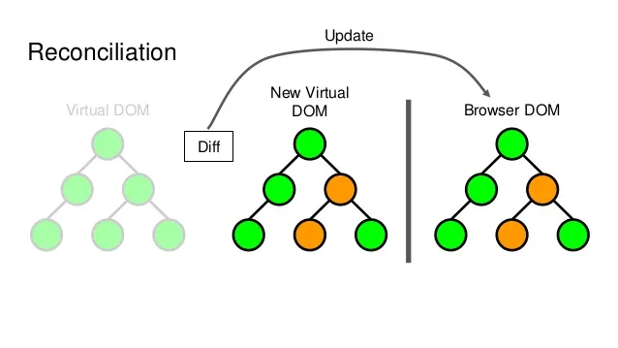
What is DOM
The Document Object Model (DOM) represents the structure of a webpage in the browser as a tree of objects.
Each object corresponds to a part of the webpage, such as elements, attributes, and text.
Issue with Direct DOM Manipulation:
Directly modifying the DOM can be slow and resource-intensive.
Frequent changes to the DOM can lead to reflows and repaints, causing performance bottlenecks.
KRISHNA CHAITANYA INSTITUTE OF TECHNOLOGY & SCIENCES
March - 2024
12

Slide 13
Virtual DOM
A virtual DOM is a lightweight JavaScript representation of the Document Object Model (DOM) used in React.
Updating the virtual DOM is comparatively faster than
updating the actual DOM (via JavaScript).
Here's how it works:
The ReactDOM creates a virtual DOM tree that mirrors the actual DOM tree.
When the state of the application changes, the ReactDOM updates the virtual DOM tree.
KRISHNA CHAITANYA INSTITUTE OF TECHNOLOGY & SCIENCES
March - 2024
13

Slide 14
Virtual DOM
The ReactDOM then compares the virtual DOM tree to the actual DOM tree and identifies the changes that need to be made.
The ReactDOM makes the necessary changes to the actual DOM tree.
KRISHNA CHAITANYA INSTITUTE OF TECHNOLOGY & SCIENCES
March - 2024
14

Slide 15
What is JSX
JSX stands for JavaScript XML.
JavaScript
It is an extension of the JavaScript language that allows you to write HTML-like code inside of JavaScript.
HTML
This combination of JavaScript and HTML-like syntax makes it easier to create and visualize the UI structure directly in your code.
KRISHNA CHAITANYA INSTITUTE OF TECHNOLOGY & SCIENCES
March - 2024
15

Slide 16
Advantages
Performance: React uses a virtual DOM to track changes to the UI. This allows React to update the UI more efficiently than traditional frameworks. This is important for applications that need to be responsive and performant.
Scalability: React is scalable, which means that it can be used to build large and complex applications. This makes React a good choice for enterprise-level applications.
KRISHNA CHAITANYA INSTITUTE OF TECHNOLOGY & SCIENCES
March - 2024
16

Slide 17
Advantages
Declarative: React is a declarative framework, which means that you describe what you want the UI to look like, rather than how to get it there. This makes React code easier to read and understand.
Reusable components: React is based on components, which are reusable pieces of code that can be combined to create complex UIs. This makes React code more modular and easier to maintain.
Large community: React's active community constantly creates tools and resources, providing help for developers facing issues.
KRISHNA CHAITANYA INSTITUTE OF TECHNOLOGY & SCIENCES
March - 2024
17

Slide 18
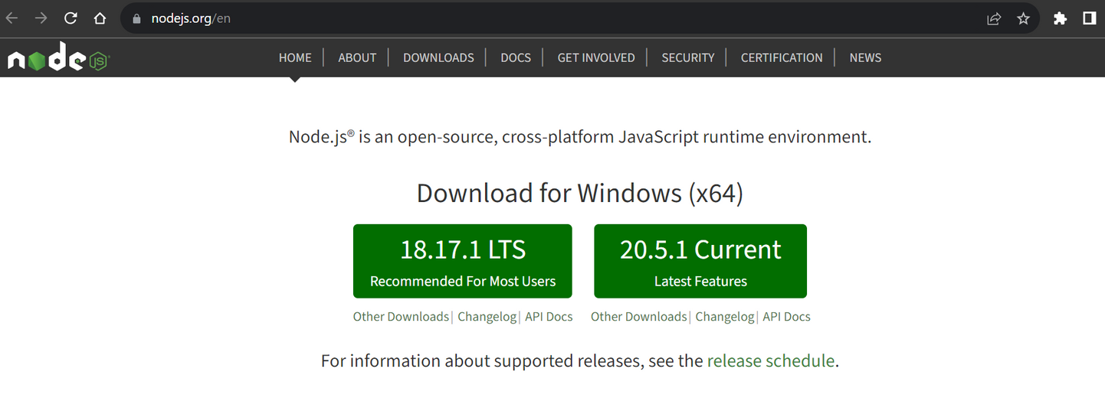

Installation
Step 1: Install Node.js
Site Link: https://nodejs.org/en
Visit the Node.js official website by using the above link.
Here Download the LTS version.
Once downloaded open NodeJS without disturbing other settings, click on the Next button until it’s completely installed.
KRISHNA CHAITANYA INSTITUTE OF TECHNOLOGY & SCIENCES
March - 2024
18

Slide 19
Installation
Step 2: Verify installation.
Open your terminal (or command prompt on Windows).
Run the following commands to verify that Node.js and npm are installed.
Command Prompt
C:\>node -v
v18.17.1
C:\>npm -v
9.6.7
You should see version numbers for both Node.js and npm if the installation was successful.
Now that you have Node.js and npm installed, you can proceed to install React.js and create a new React application.
KRISHNA CHAITANYA INSTITUTE OF TECHNOLOGY & SCIENCES
March - 2024
19

Slide 20
Installation
Step 3: Install Create React App.
Create React App is a tool that sets up a new React application with a good default configuration.
In your terminal, run the following command to install Create React App globally (you might need to use sudo on macOS/Linux).
Command Prompt
C:\>npm install -g create-react-app
To check everything went well run the command.
Command Prompt
C:\>create-react-app --version
5.0.1
If everything went well it will give you the installed version of react app.
KRISHNA CHAITANYA INSTITUTE OF TECHNOLOGY & SCIENCES
March - 2024
20

Slide 21
Installation
Step 4: Create a Newfolder.
Create a new folder where you want to make your react app using the below command.
Command Prompt
C:\>mkdir React
Enter Your Folder name in the place of React.
Move inside the same folder using the below command.
Command Prompt
C:\>cd React
C:\React>
Now you're inside your folder.
KRISHNA CHAITANYA INSTITUTE OF TECHNOLOGY & SCIENCES
March - 2024
21

Slide 22
Installation
Step 5: Create a New React App.
Once you're in your folder, you can create a new React application by running this command.
Command Prompt
C:\React>create-react-app reactdemo
Creating a new React app in C:\React\reactdemo.
Installing packages. This might take a couple of minutes.
Installing react, react-dom, and react-scripts with cra-template...
Your app name
Replace "reactdemo" with the desired name for your application.
This command will create a new directory with the same name containing the project files.
NOTE: Due to npm naming restrictions, names can no longer contain capital letters, thus type your app’s name in lowercase.
KRISHNA CHAITANYA INSTITUTE OF TECHNOLOGY & SCIENCES
March - 2024
22

Slide 23
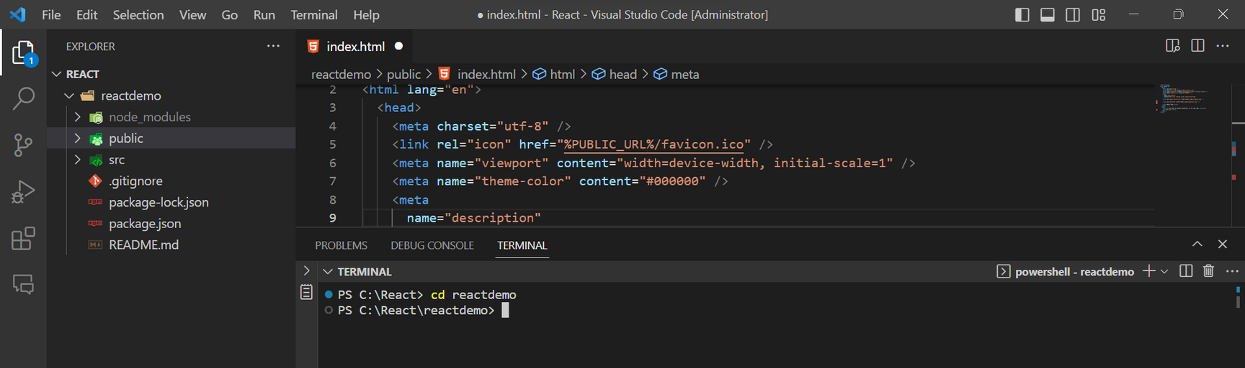
Installation
Step 6: Open any IDE (VS code)
Open the folder where you have installed the react app ('React' -my folder).
Inside the folder you will see your app’s name ( 'reactdemo' -my app name).
Use the terminal and move inside your app name folder.
Use command cd reactdemo <--(your app name)
KRISHNA CHAITANYA INSTITUTE OF TECHNOLOGY & SCIENCES
March - 2024
23

Slide 24
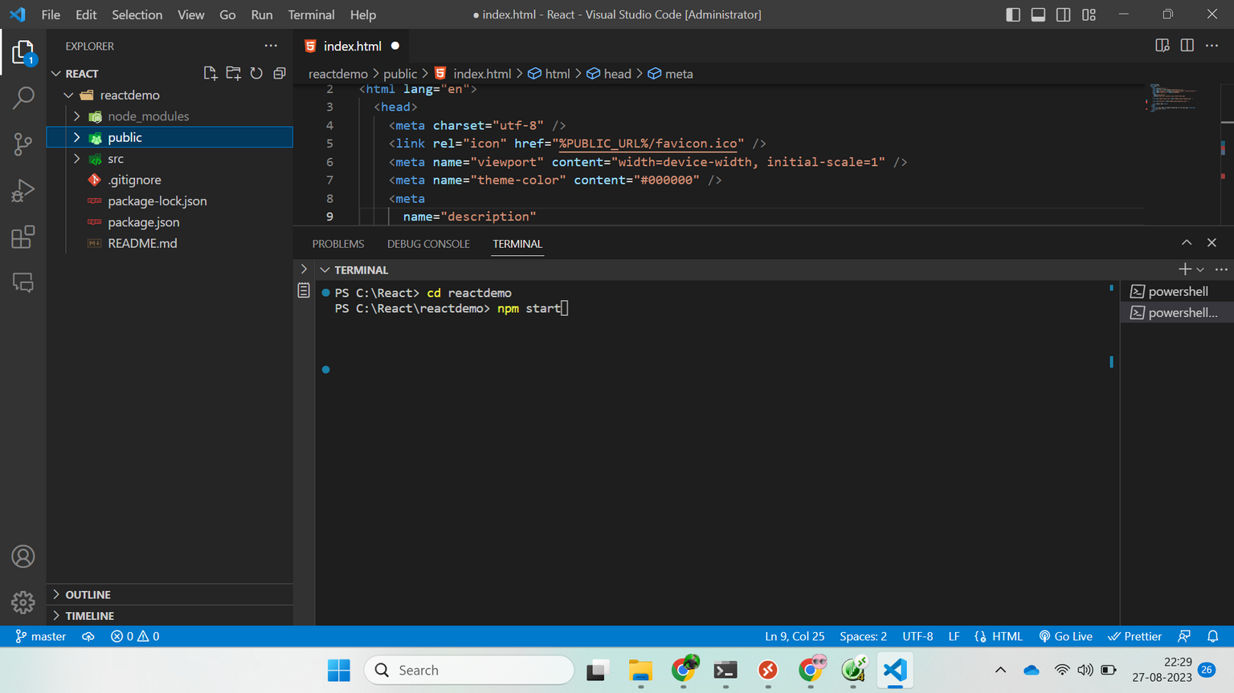
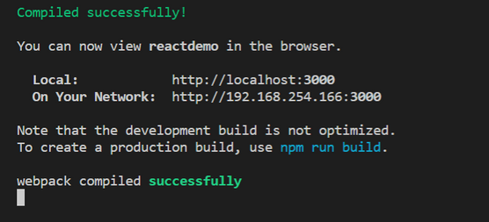
Installation
Step 7: Start the Development Server.
To start the development server and see your React app in action, type this.
npm start
KRISHNA CHAITANYA INSTITUTE OF TECHNOLOGY & SCIENCES
March - 2024
24

Slide 25
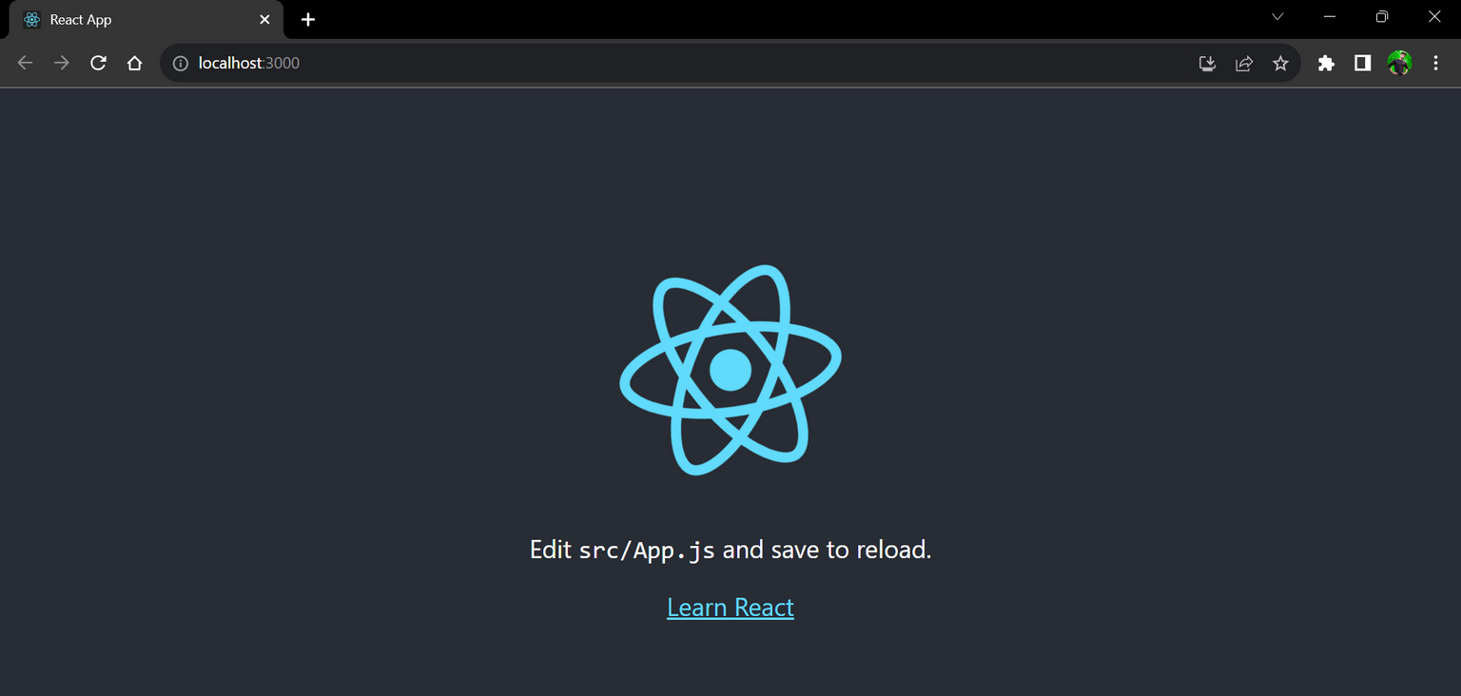
Installation
This command will start the development server and automatically open a new browser window/tab with your React app running.
Congratulation! you have successfully installed the react-app and are ready to build awesome websites and app.
KRISHNA CHAITANYA INSTITUTE OF TECHNOLOGY & SCIENCES
March - 2024
25

Slide 26
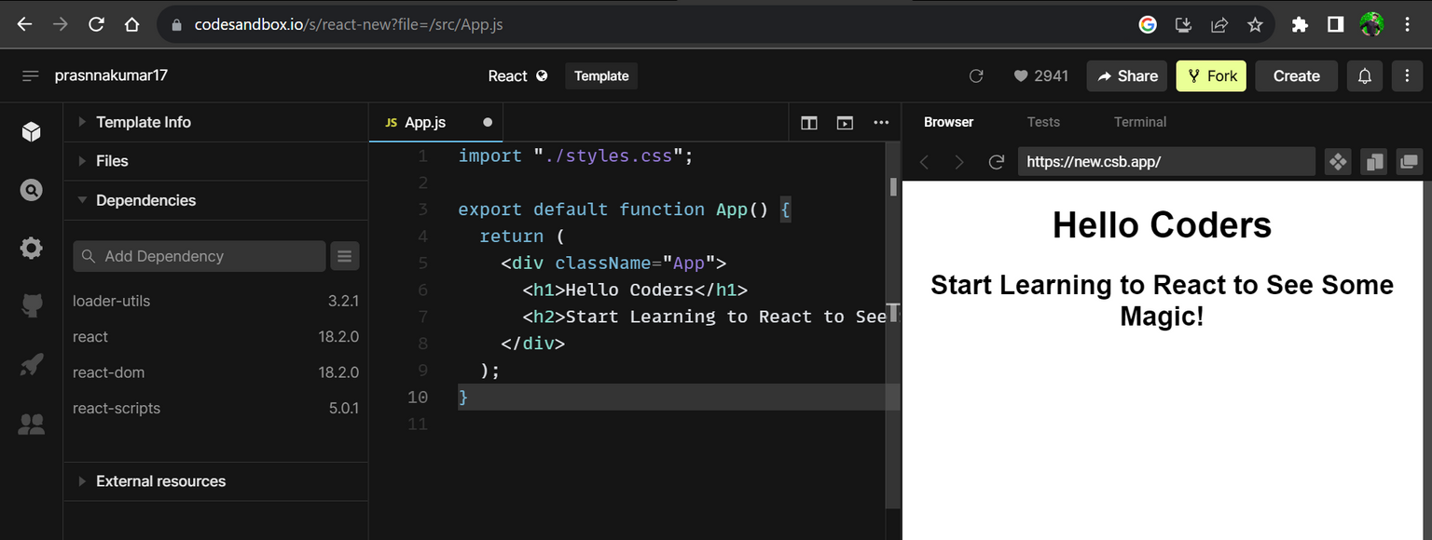
Online Setup
Visit Code Sandbox website
Dependencies
react
react-dom
KRISHNA CHAITANYA INSTITUTE OF TECHNOLOGY & SCIENCES
March - 2024
26

Slide 27
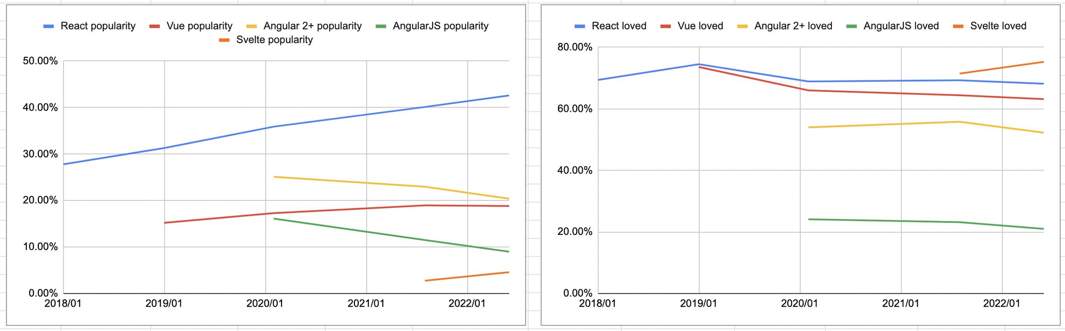
Industry Demand
React.js is a fast-growing future technology.
KRISHNA CHAITANYA INSTITUTE OF TECHNOLOGY & SCIENCES
March - 2024
27

Slide 28
Companies Offering Jobs
wipro
Accenture
Capgemini
infosys
Siemens
BigShyft
Fiverr
Meta(Facebook)
Netflix
Uber
Pinterest
Airbnb
Wix
Skype etc.
Many more startups and service-based companies need React developers.
KRISHNA CHAITANYA INSTITUTE OF TECHNOLOGY & SCIENCES
March - 2024
28

Slide 29
Jobs on React
Job Board | Angular | React | Vue
LinkedIn | 136,600 | 154,264 | 95,784
Indeed | 16,370 | 61,799 | 3,780
Glassdoor | 28,780 | 54,715 | 91
ZipRecruiter | 31,315 | 55,376 | 8,210
Naukri | 14,904 | 8,981 | 954
Total | 227,969 | 335,135 | 108,819
KRISHNA CHAITANYA INSTITUTE OF TECHNOLOGY & SCIENCES
March - 2024
29

Slide 30
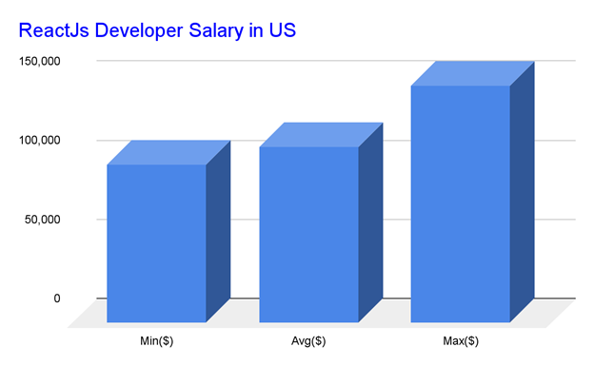
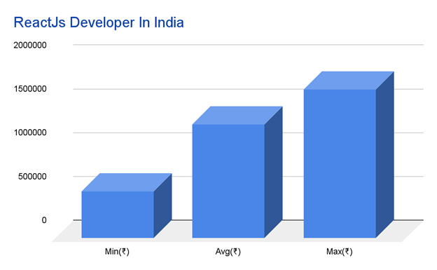
Packages on React
A React.JS developer with less than a year of experience can expect to make about ₹400,000 - ₹600,000 annually.
2–3 years of experience can earn 600,000–800,000 LPA.
5-6 years of experience can earn 1000,000–1300,000 LPA.
KRISHNA CHAITANYA INSTITUTE OF TECHNOLOGY & SCIENCES
March - 2024
30

Slide 31
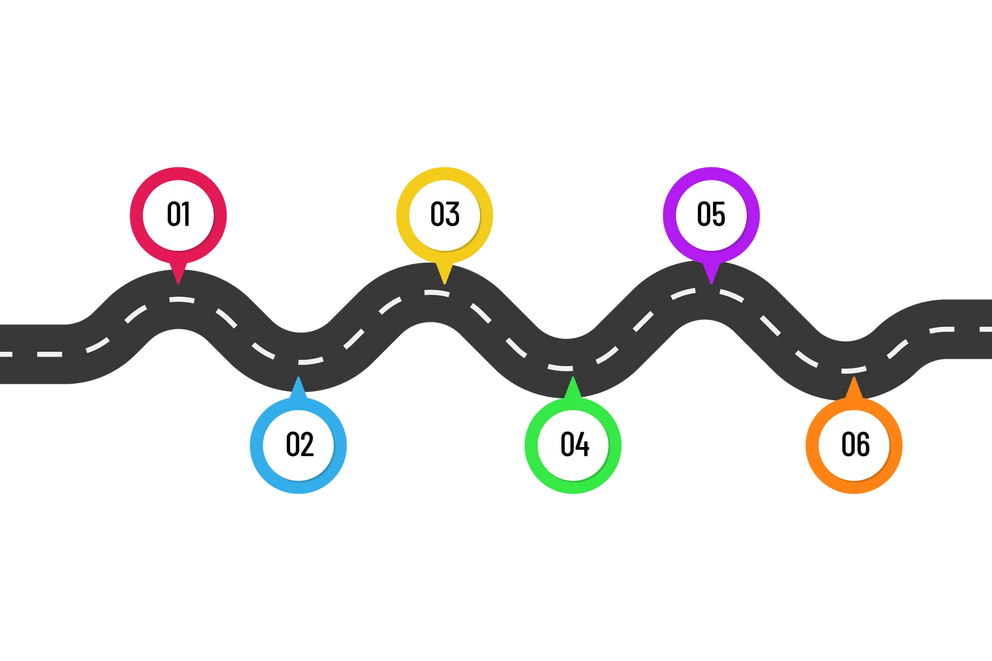


Roadmap
HTML
( 2-3 Days )
JavaScript Basics
( 2 - 3 Weeks )
Git/GitHub
( 1 - 2 Weeks )
Beginner
React
Developer
CSS
( 10 -15 Days )
React Basics
( 2 - 3 Weeks )
Advanced React
( 4 - 5 Weeks )
KRISHNA CHAITANYA INSTITUTE OF TECHNOLOGY & SCIENCES
March - 2024
31

Slide 32
Next Steps
React.js Docs : https://legacy.reactjs.org/
React.js Course : https://react-tutorial.app/
React.js Video Course : https://youtu.be/Academind
Project Idea’s : Interviewbit, Geeksforgeeks
KRISHNA CHAITANYA INSTITUTE OF TECHNOLOGY & SCIENCES
March - 2024
32

Slide 33
Summary
React.js is a powerful JavaScript library for building user interfaces.
It is Reusable, efficient and flexible.
It is used by many large companies.
If you are looking to build user interfaces, React.js is a great option.
KRISHNA CHAITANYA INSTITUTE OF TECHNOLOGY & SCIENCES
March - 2024
33

Slide 34
Thank You
KRISHNA CHAITANYA INSTITUTE OF TECHNOLOGY & SCIENCES
March - 2024
33

